Slide 1

REAL-TIME BASED FACIAL RECOGNITION SYSTEM USING TWILIO
Under the Guidance of
Mrs.L.Pallavi, Assistant Professor
Department of Computer Science & Engineering
B V Raju Institute of Technology, Narsapur
Presented by
Presented by
P.Ajay kumar ,17211A05M2
P.Saiteja, 17211A05M5
S.Tirumal ,17211A05P3
K.Sheshasai, 18215A0534

Slide 2
Abstract
Abstract
Introduction
Modules
Architecture Model
Software/Hardware Requirements
Screenshots
Conclusion
Future Enhancement
References
A facial recognition system is a technology capable of identifying or verifying a person from a digital image or a video frame from a video source.
There are multiple methods in which facial recognition systems work, but in general, they work by comparing selected facial features from given image with faces within a database.
When a digital image or video frame of a criminal is identified it sends a message to nearby police station or to the shop owner.

Slide 3
Abstract
Introduction
Modules
Architecture Model
Software/Hardware Requirements
Screenshots
Conclusion
Future Enhancement
References
Abstract
Introduction
Existing System
Proposed System
Software requirements
Architecture Model
Modules
UML Diagrams/ER Diagrams/Flow Charts
References
Introduction
Face recognition is one of the widely used technologies or systems in which it has the potential to perform tasks such as to have records provided in by the dataset in many areas such as the school and colleges attendance systems, it can also be helpful in catching the thieves or the terrorist, can be helpful in the security of common people and the much needed security areas in the country.
Here we are developing this project for identifying wanted criminals who are freely roaming around us.

Slide 4
Modules
Abstract
Introduction
Modules
Architecture Model
Software/Hardware Requirements
Screenshots
Conclusion
Future Enhancement
References
Login
To recognise faces using KNN
Read video stream using opencv.
Extract faces out for training
Load training data
Real time comparison
If found sending SMS using Twilio

Slide 5
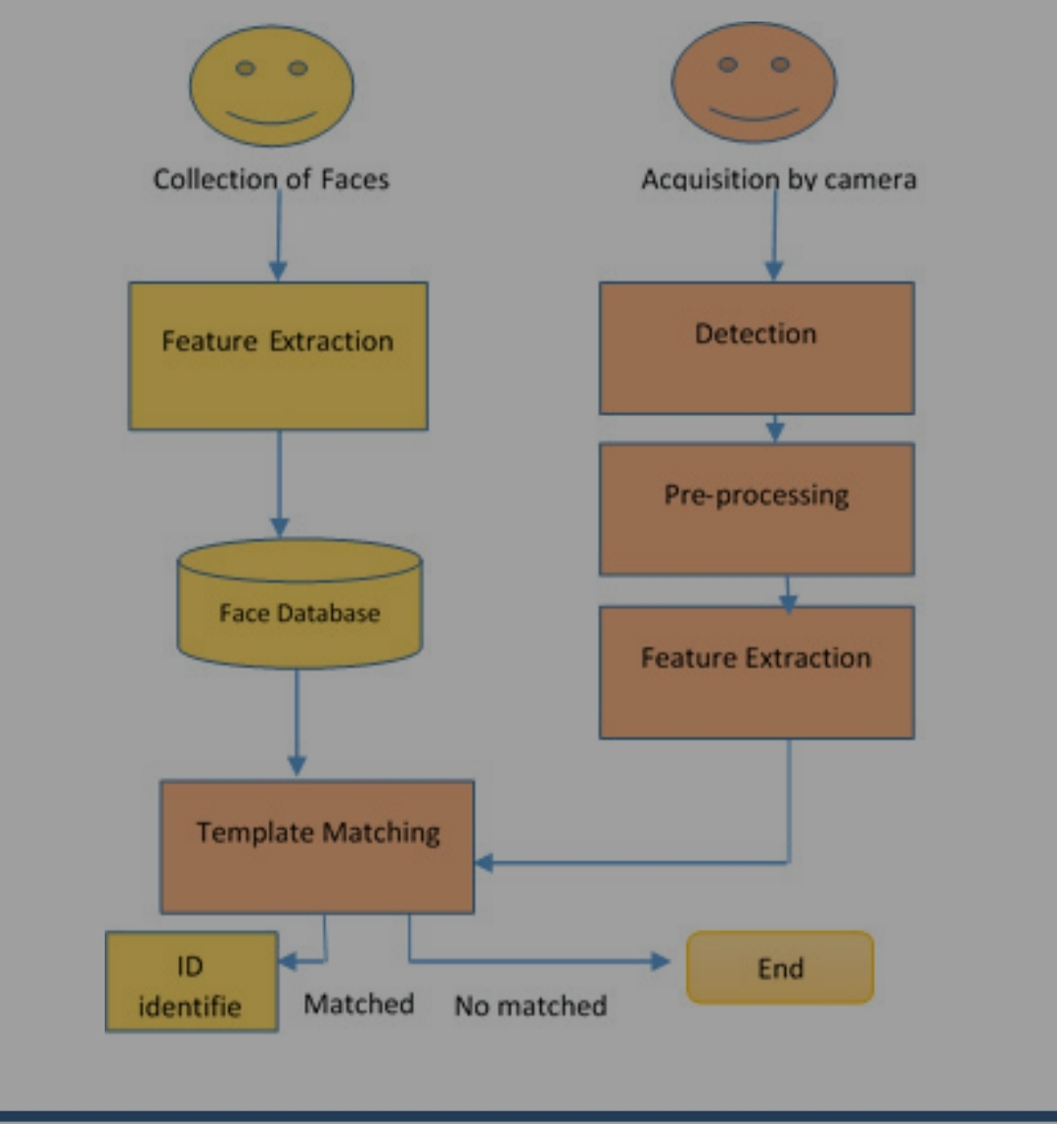
Architectural Model
Abstract
Introduction
Modules
Architecture Model
Software/Hardware Requirements
Screenshots
Conclusion
Future Enhancement
References

Slide 6
Introduction
Existing System
Proposed System
Software Requirements
References
Abstract
Introduction
Modules
Architecture Model
Software/Hardware Requirements
Screenshots
Conclusion
Future Enhancement
References
Software/Hardware Requirements
HARDWARE REQUIREMENTS:
Processor : i3 Or More.
Hard Disk : Minimum 50 Gb.
Display : Led/Led Colour.
Accessories : Web Cam, Keyboard & Mouse.
Ram : Minimum 2 Gb.
SOFTWARE REQUIREMENTS:
Python
Opencv-4.2.0
Numpy-1.18
Haarcascade_frontalface_default.xml

Slide 7
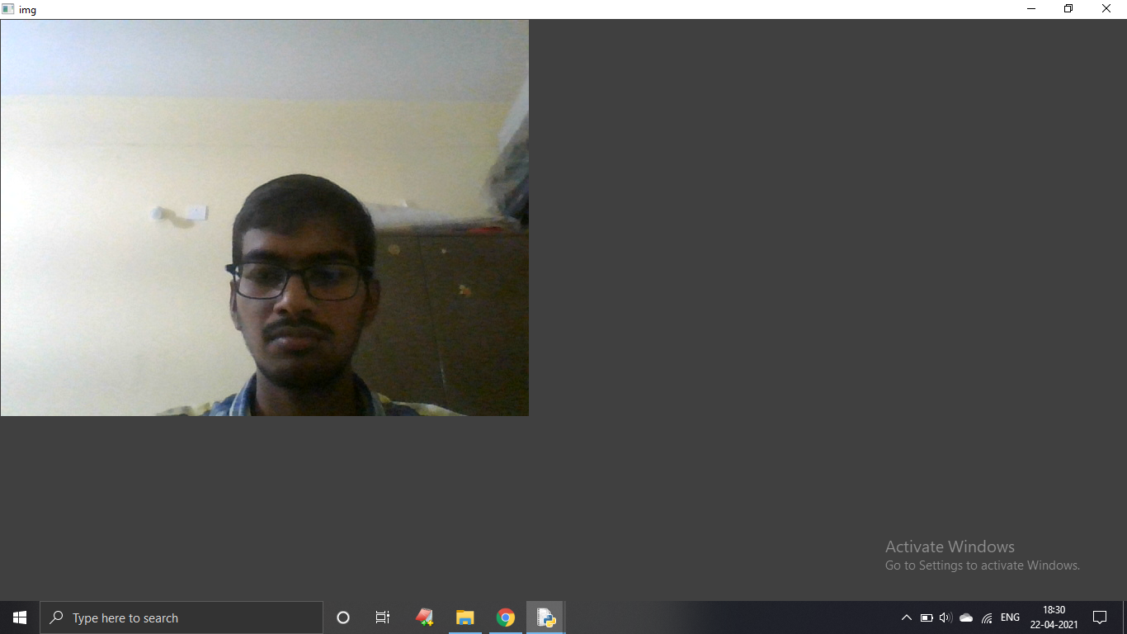
Screenshots
Abstract
Introduction
Modules
Architecture Model
Software/Hardware Requirements
Screenshots
Conclusion
Future Enhancement
References
DATASET CREATION

Slide 8
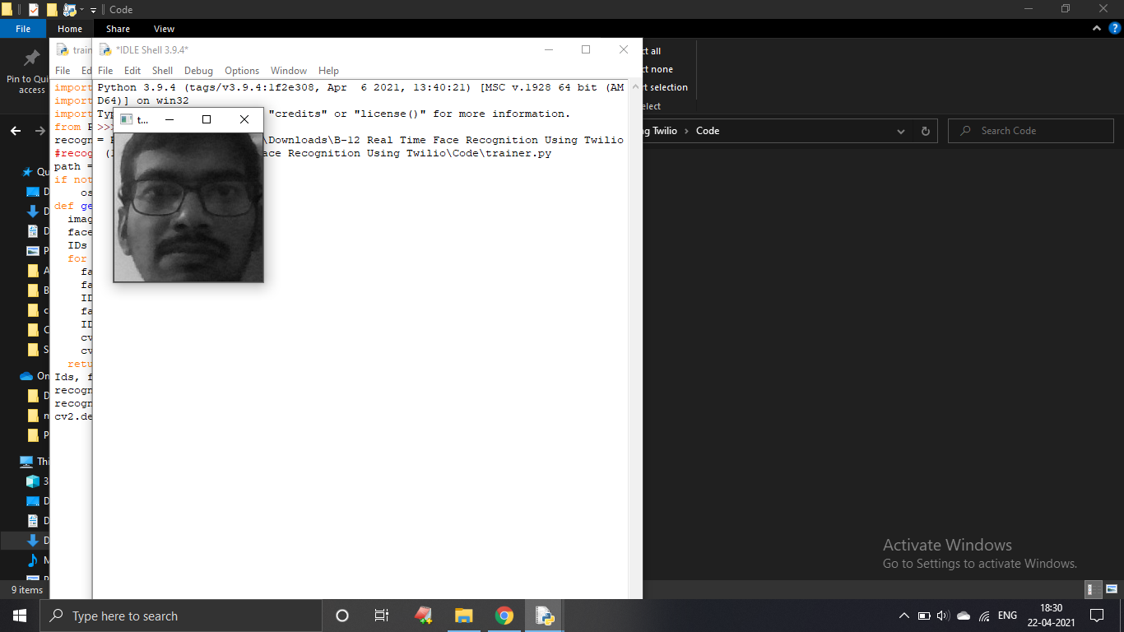
Screenshots
Abstract
Introduction
Modules
Architecture Model
Software/Hardware Requirements
Screenshots
Conclusion
Future Enhancement
References
DATA TRAINING

Slide 9
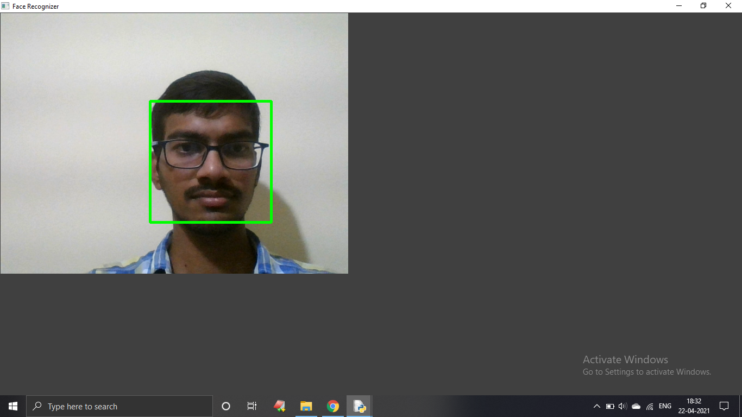
Screenshots
Abstract
Introduction
Modules
Architecture Model
Software/Hardware Requirements
Screenshots
Conclusion
Future Enhancement
References
DATASET DETECTION

Slide 10
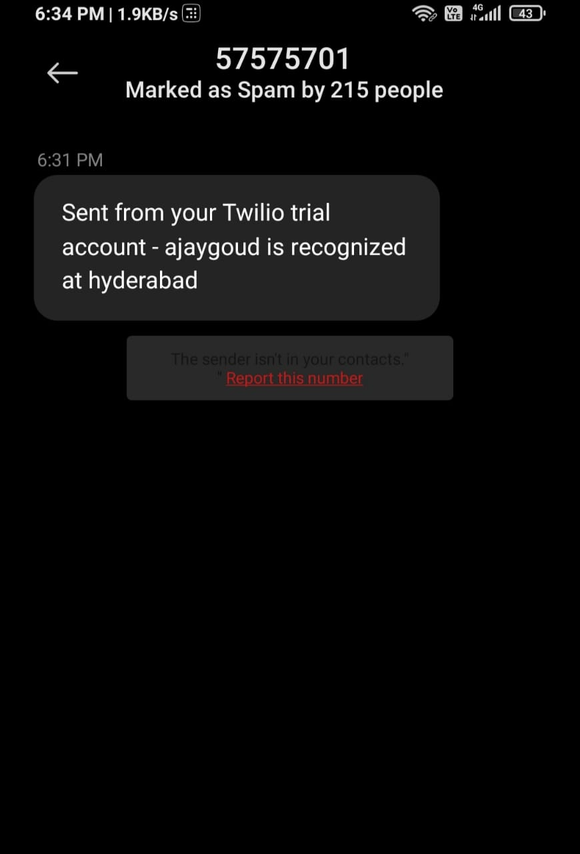
Screenshots
Abstract
Introduction
Modules
Architecture Model
Software/Hardware Requirements
Screenshots
Conclusion
Future Enhancement
References
SMS RECEIVED WHEN RECOGNIZED

Slide 11
Conclusion
Abstract
Introduction
Modules
Architecture Model
Software/Hardware Requirements
Screenshots
Conclusion
Future Enhancement
References
After supplying the model with training data, we have a test image streamed from the webcam and the test result is in the picture which has a bounding box around the person face. Therefore our model recognizes the face and our algorithm successfully executes its tasks.

Slide 12
Future Enhancement
Abstract
Introduction
Modules
Architecture Model
Software/Hardware Requirements
Screenshots
Conclusion
Future Enhancement
References
In Future Enhancement we want to develop 3D facial recognition to eliminate some unsolved problems in 2D like..sensitivity to light conditions, pose, Use of makeup.

Slide 13
Introduction
Existing System
Proposed System
Software requirements
References
Abstract
Introduction
Modules
Architecture Model
Software/Hardware Requirements
Screenshots
Conclusion
Future Enhancement
References
References
Abelson, E. H., and Bergen, J. R. (1986) The Extraction of Spate-Temporal Energy.
Analysis (pp. 151-155) Charleston, SC; May 7-9.
Beyer, D. and Poggio, T. (1995) Face Recognition From One Example View, A.I. Memo No. 1536, C.B.C.L. Paper No. 121. MIT.
Haralick, R.M. and Shapiro, L.G.. (1992) Computer and Robot Vision, Volume I. Addison-Wesley.
2/1

Slide 14
Q and A?
?

Slide 15
THANK YOU

